Slide 1



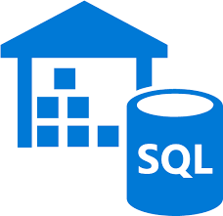

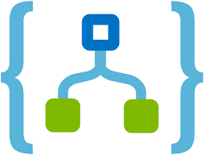
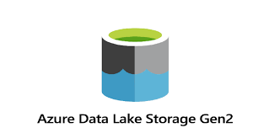
File input
New file
event
Trigger
Pipeline
Store
data
User
Sharepoint
Logic Apps
Azure Data Factory
Azure Data Warehouse
Read file
Move file
to staging

